Slide 1
VR&AR Group 2
Blind Motion Deblurring with Unpaired Dataset
using Cycle-Consistent Adversarial Networks
王浩 Hao Wang 强志文 Zhiwen Qiang
515021910060 515030910367

Slide 2
Contents
1
Introduction
2
Proposed Work
3
Limitations
4
Our Work
5
Results
6
Conclusions
Notes:
Today we will firstly introduce the original proposed method: deblurgan
and then comes its limitation and
After that is our work to try to overcome the limitation based on cycleGAN

Slide 3
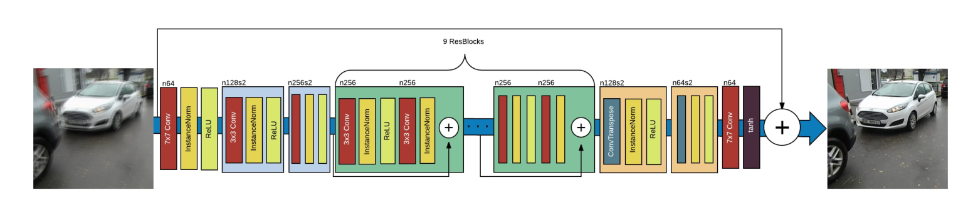
Introduction
Deblur

Slide 4
Introduction
Given:
1. no information about blurring kernel or camera movement.
2. a variety of blurred image.
Most of current methods (next slide) do not perform well.
Notes:
Using some tranditional method, we can also achieve debluring,
but what if …given…

Slide 5
Related Work
Works | features | Shortcomings
Iterative approach | Improve the estimate of the motion kernel, using parametric prior models to sharp images | Long running time Difficult to ascertain stopping criterion
local linearity model | Use a blur function and simple heuristics to quickly estimate the unknown kernel | work well on a small subset of images.
Lucy-Richardson algorithm | recovering a latent image by a known point spread function | Cannot work when the blur kernel is unknown

Slide 6
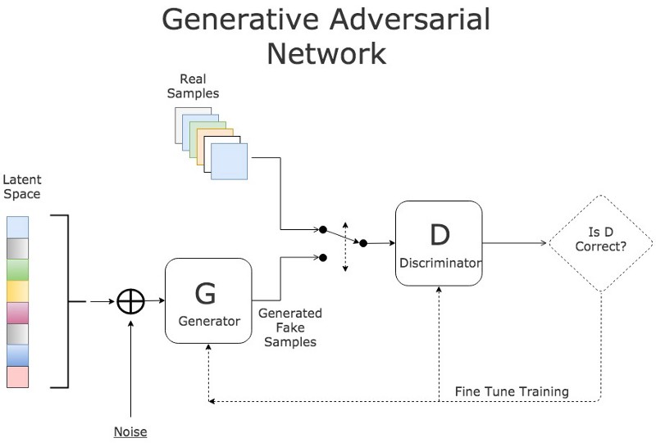
Proposed Work: GAN
Image source:https://blog.sicara.com/keras-generative-adversarial-networks-image-deblurring-45e3ab6977b5
Notes:
Before talking into the detail of deblur gan, let me simply introduce what is gan

Slide 7
Proposed Work: DeblurGAN
DeblurGAN generator architecture
The network is based on ResNet blocks. It keeps track of the evolutions applied to the original blurred image.
Notes:
Lets come to the deblurgan,
It is mainly based on resnet blocks
One feature of resnet is that the input will be added to the output layer in order to increase the networks’ stability

Slide 8
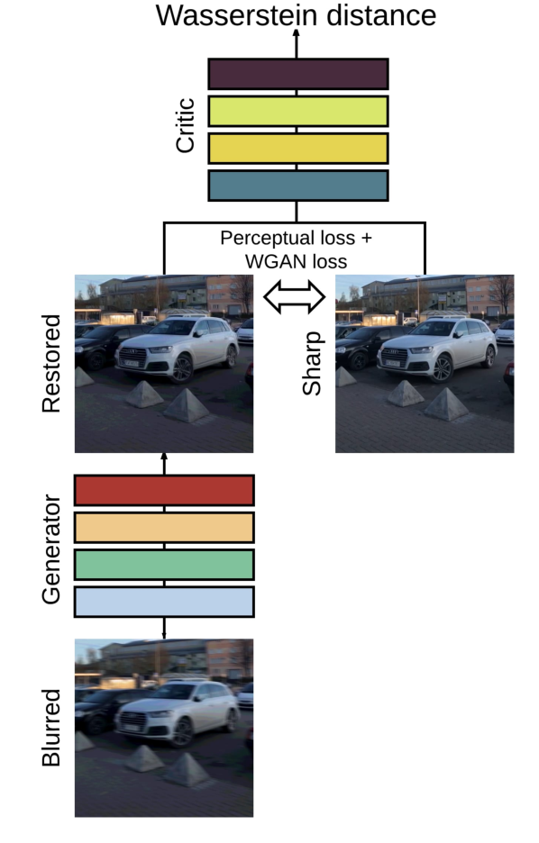
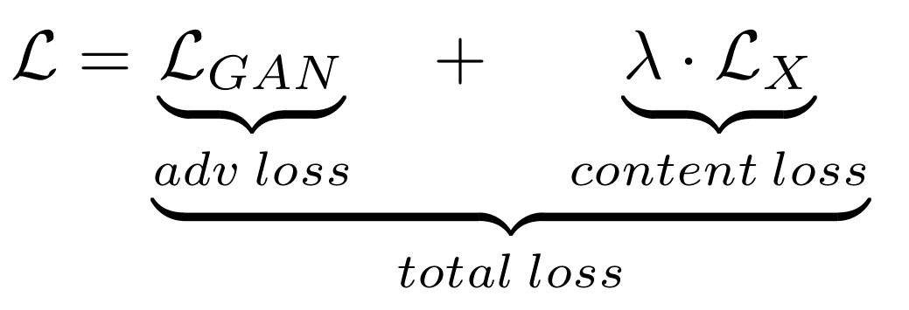
Proposed Work: DeblurGAN
loss function
An illustration of the full objective
Notes:
Here is the overall chart of the deblur gan, there are two main loss.

Slide 9
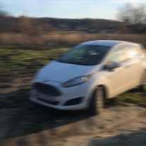
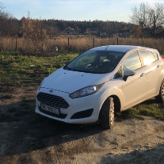
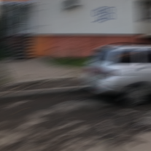
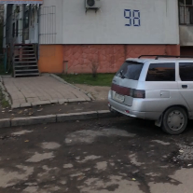
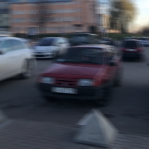
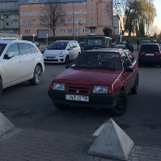
Limitations
Require pairwise dataset to complete the training.
Not easy to get pairwise dataset.
The blurring images in the training set are fake (use algo. to generate them).
……
Blur Sharp
Pairwise dataset
Notes:
First of all,
Then is the it is kind of ridiculous to

Slide 10
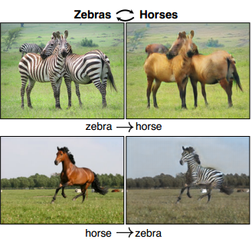
Our Work: CycleGAN
Unpaired image to image translation.
Treat ‘blur’ and ‘sharp’ as a kind of image style.
Image source: J. Zhu, T. Park, P. Isola, and A. A. Efros, “Unpaired image-to-image translation using cycle-consistent adversarial networks,”

Slide 11
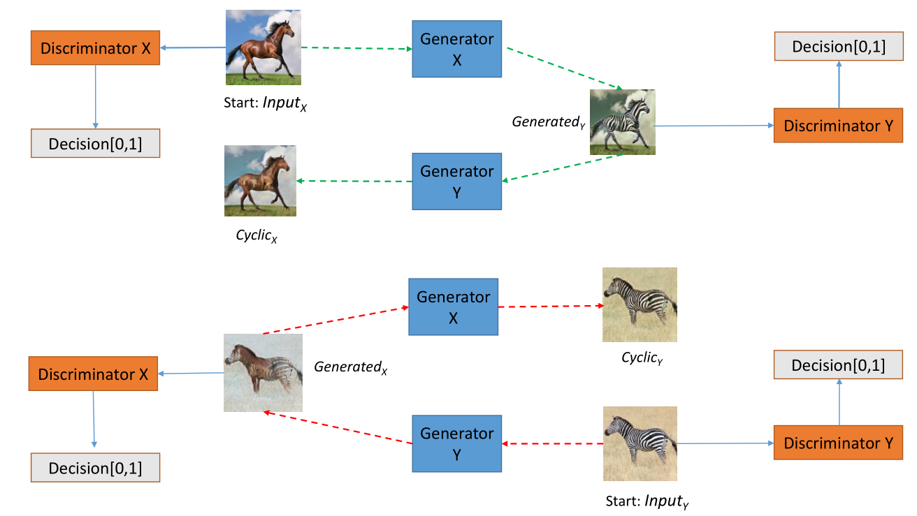
CycleGAN
Pipeline for the cycleGAN

Slide 12
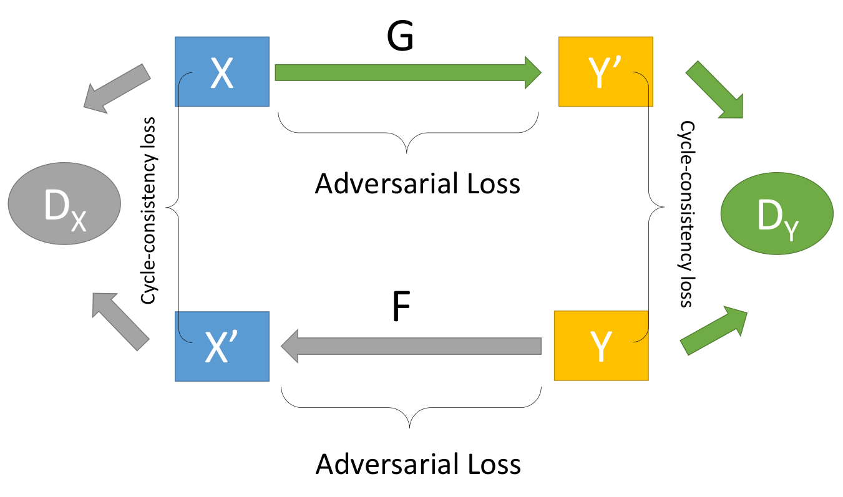
Our Work: Cycle GAN
Real blurred
image collection
GX
Fake sharp
image collection
GY
Fake blurred
image collection
Real sharp
image collection
An illustration of the full objective

Slide 13
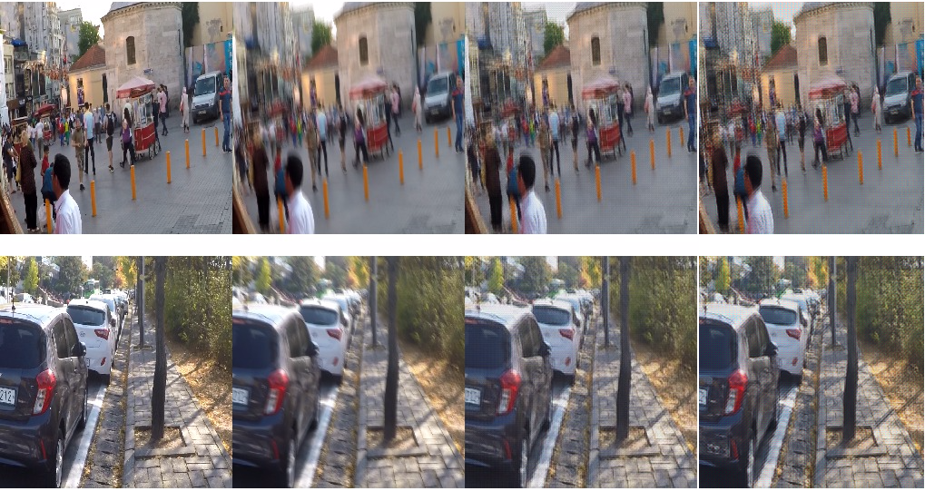
Results: DeblurGAN
From left to right: ground truth sharp image, blurred photo, result of DeblurGAN obtained by us, result of DeblurGAN presented in the paper.

Slide 14
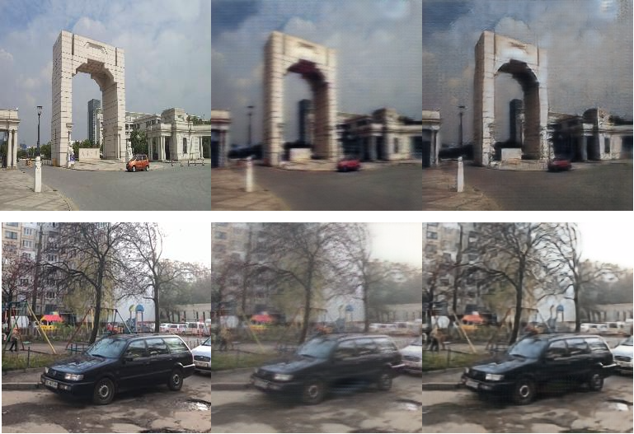
Results: CycleGAN
Cycle Consistency
1 : ground truth sharp image
2 : 1 blurred by CycleGAN
3: 2 deblurred by CycleGAN
1 2 3

Slide 15
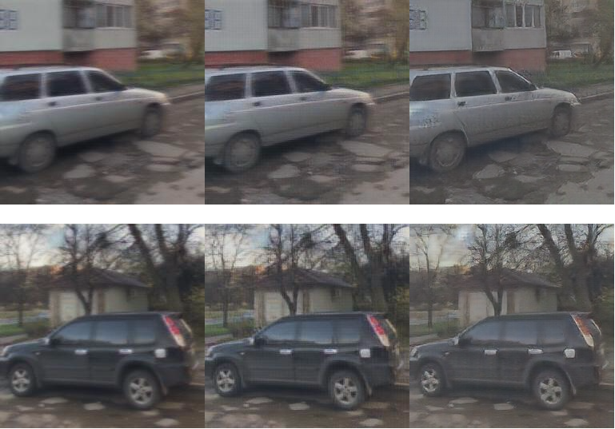
Results: Comparison
blurred image, result of DeblurGAN, result of CycleGAN

Slide 16
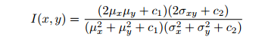
Results: Metric
Structural Similarity Index （SSIM）: used for measuring the similarity of two images.
Unlike Mean Square Error, the SSIM takes the nearby pixels of the pixel at (x, y) into consideration.

Slide 17
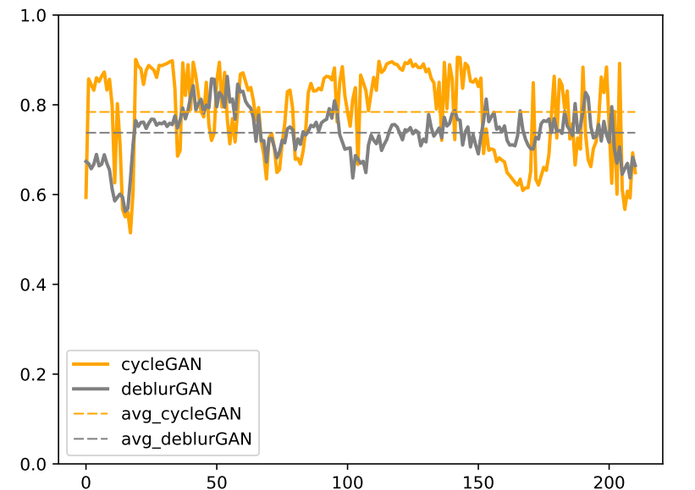
Results: Comparison
CycleGAN (ours)
DeblurGAN
CycleGAN
SSIM
0.737
0.784
DeblurGAN
MSE
667.3
565.7
result measured by SSIM

Slide 18
Contributions
Validate and re-implement the proposed work: DeblurGAN.
Proposed a blind-motion deblurring method based on CycleGAN with unpaired images as training dataset.
Get results which outperform the original work.
Proposed a automatic blurring method using CycleGAN.

Slide 19
Thank you!
Source code, dataset and implementation tutorials are available on: https://github.com/QLightman/VRAR-Course-Project

